Slide 1
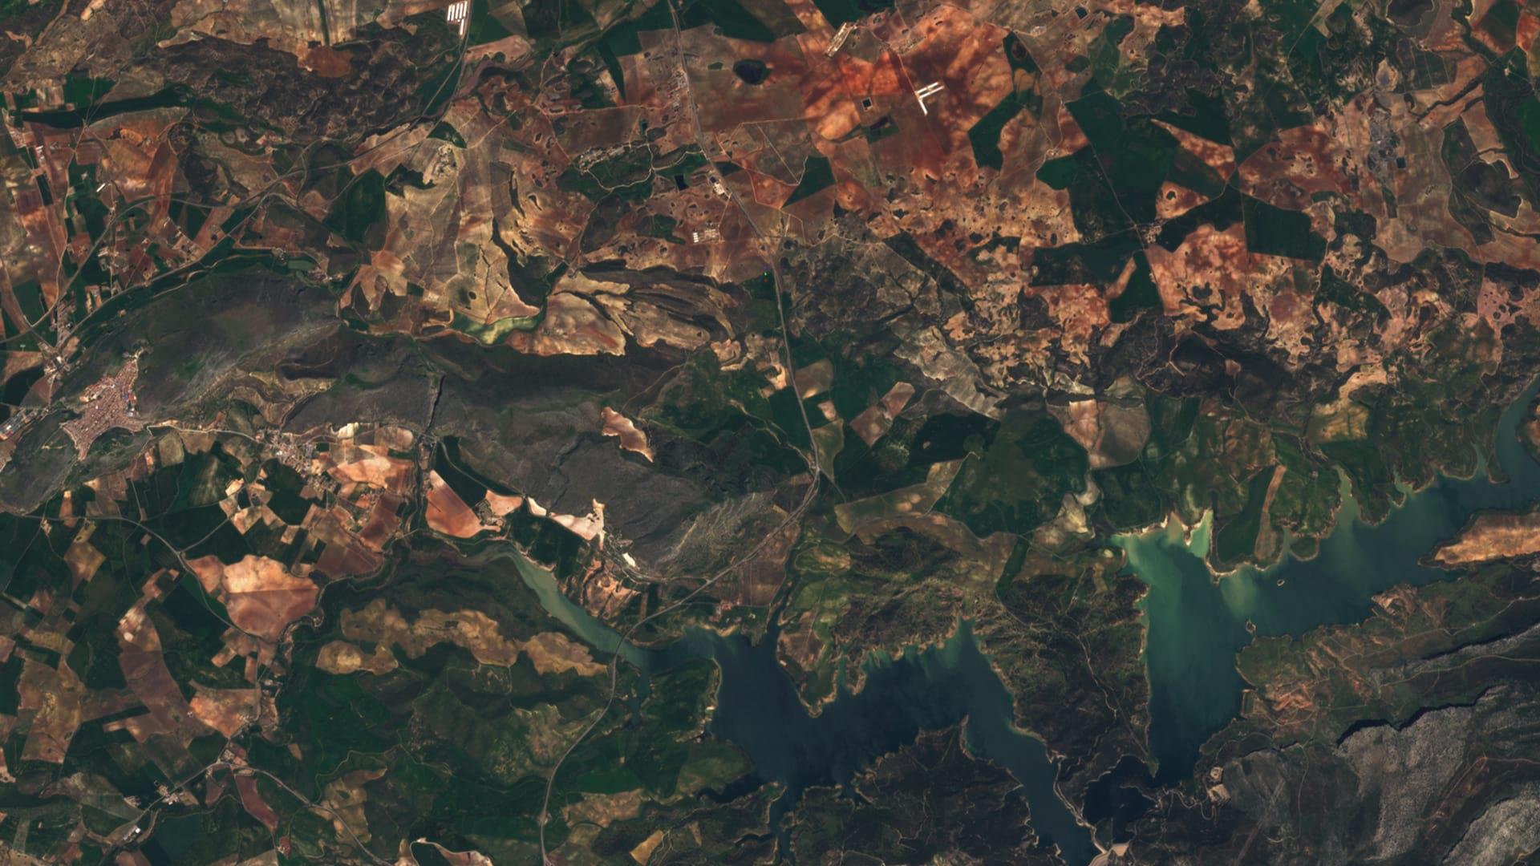

Sentinel Hub and eo-learn Bridging Earth Observation data and Machine Learning in Python
EO Research team, Sinergise, 2019

Slide 2
Overview
Revolution in Earth Observation
Challenges of Machine Learning in Earth Observation
How can one start the exploration?

Slide 3
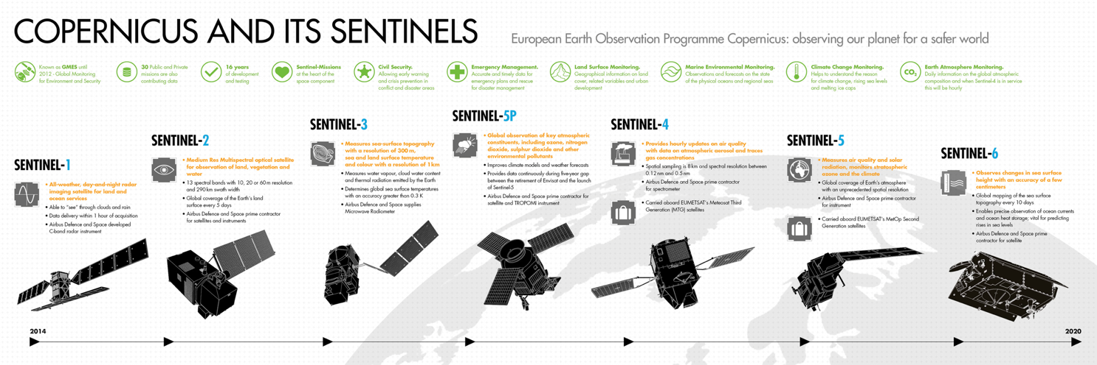
Revolution in EO
Few (commercial) satellites
Expensive imagery
Scarce temporal revisit
Various resolutions
A lot of satellites
Free and open imagery
High temporal revisit
Various resolutions

Slide 4
Revolution aka chaos in EO
How to work with all these various files (file types)?
Where is meta-data and what is in it?
Which projection is it?
Where can one find the data?
How can one access the data?
How to process all these data?
For non-EO experts: chaos
For EO experts: lots of tedious and costly work

Slide 5
Sentinel Hub™ (sentinel-hub.com)
Q: How to allow users to seamlessly and reliably access and use > 2 PB of data?
A: With Sentinel Hub™!
https://services.sentinel-hub.com/ogc/wcs/<INSTANCE>
?SERVICE=WCS&REQUEST=GetCoverage
&COVERAGE=1_VV_ORTHORECTIFIED
&TIME=2018-07-17/2018-07-17
&BBOX=15.28815,107.07000,14.75496,106.09153
&RESX=20m&RESY=20m
&FORMAT=image/tiff
&SRS=EPSG:4326

Slide 6
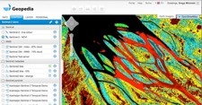
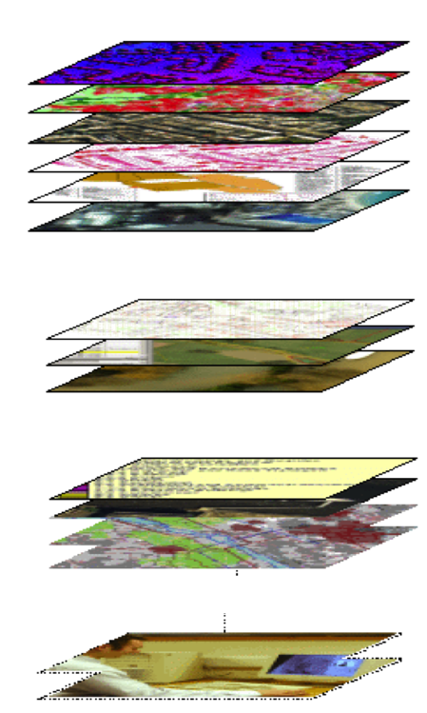

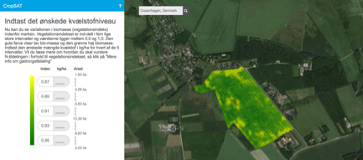

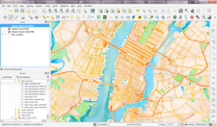
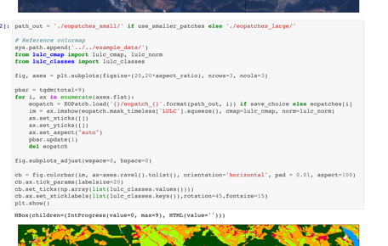
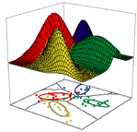
Open EO data - Sentinel-1, Sentinel-2, Landsat, etc.
Cloud GIS
WMTS
Commercial EO data – WorldWind, GeoEye,...
WMS
Web / Mobile apps
WCS
Aerial imagery (drone, plane)
API
Desktop (QGIS,, ArcGIS…)
Other raster data
Machine learning
Scripting (Python, R, ENVI…)

Slide 7
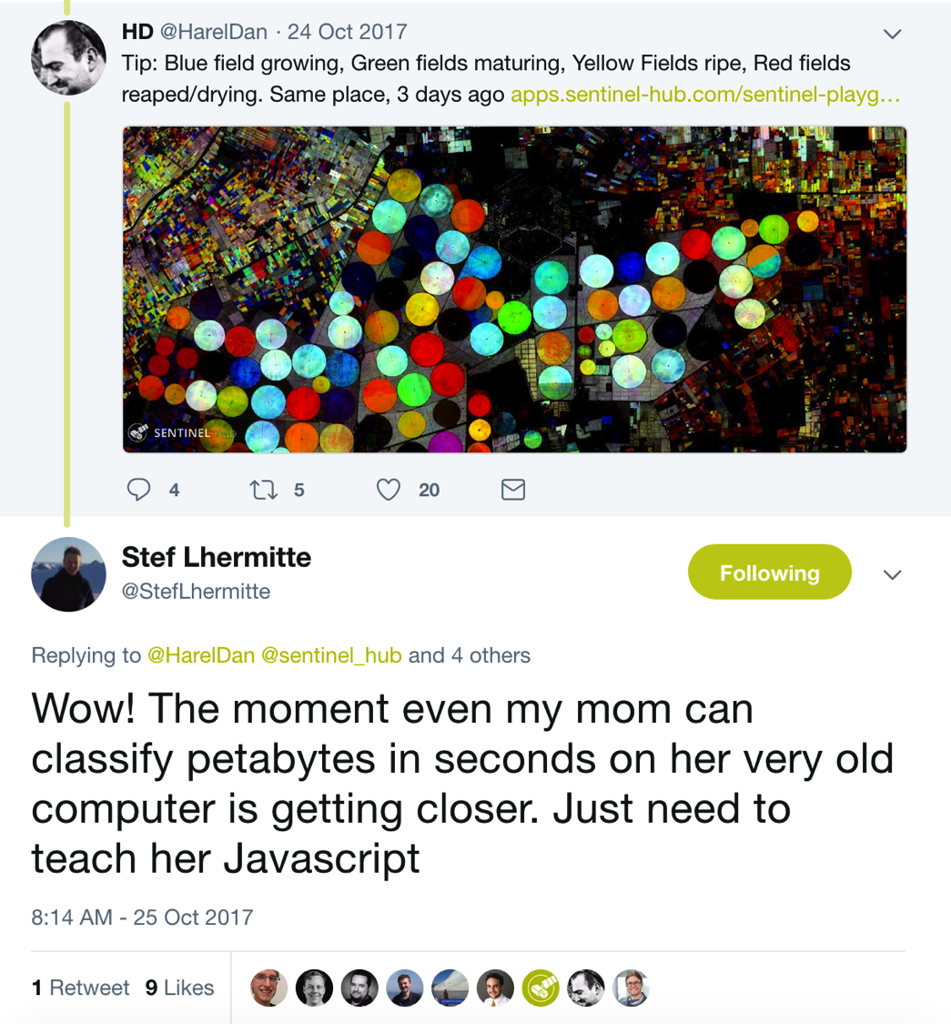

Slide 8
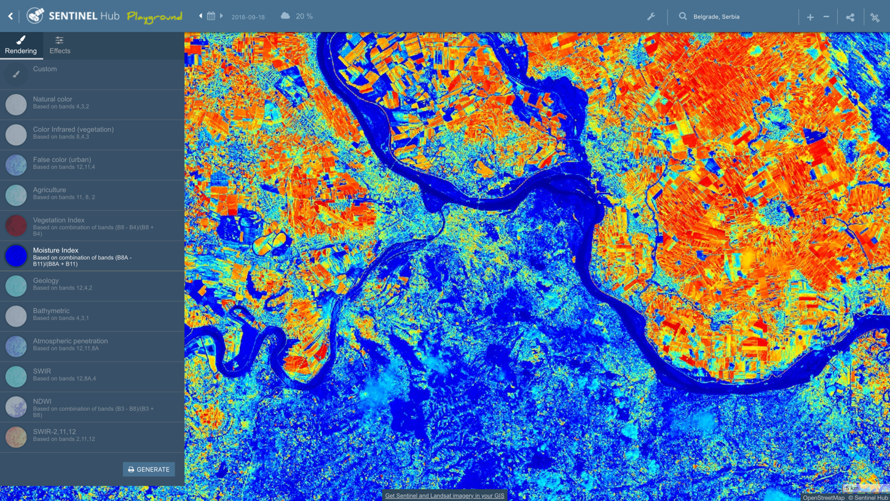
Sentinel Playground
https://apps.sentinel-hub.com/sentinel-playground/

Slide 9
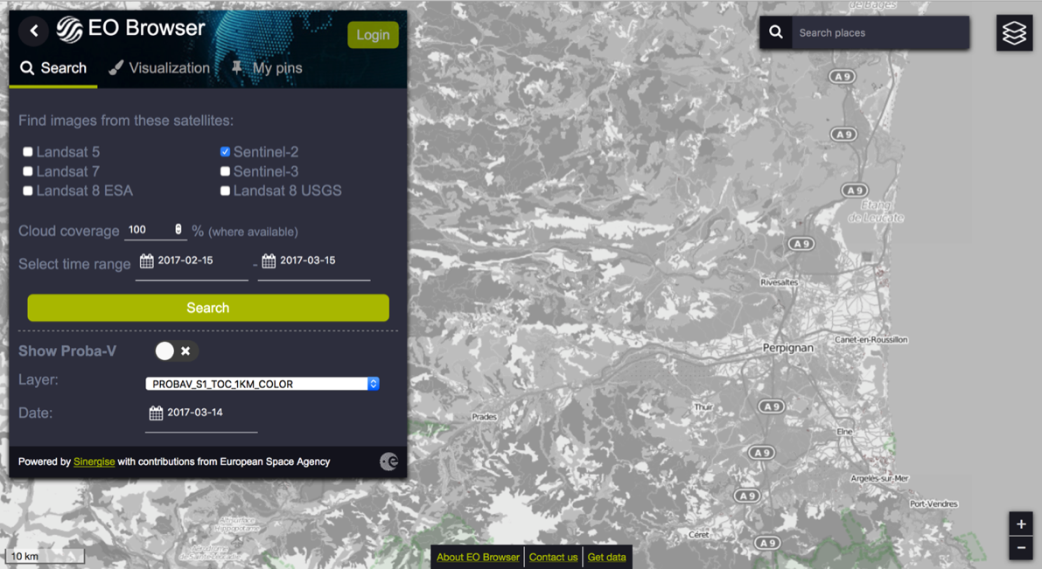
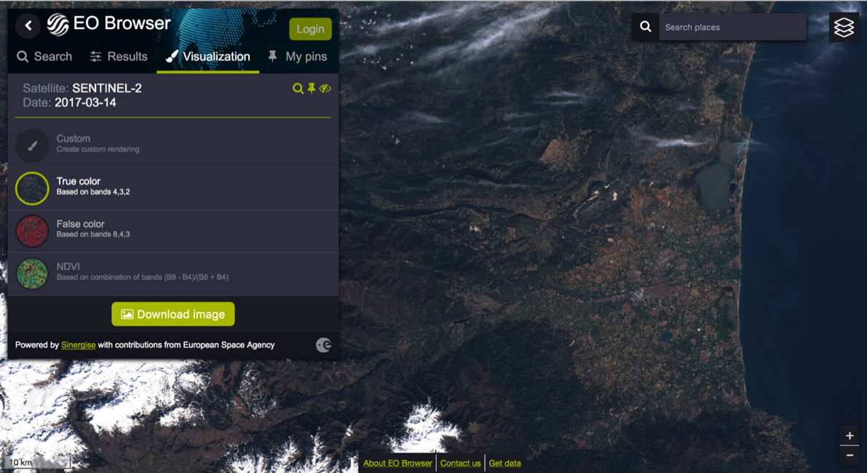
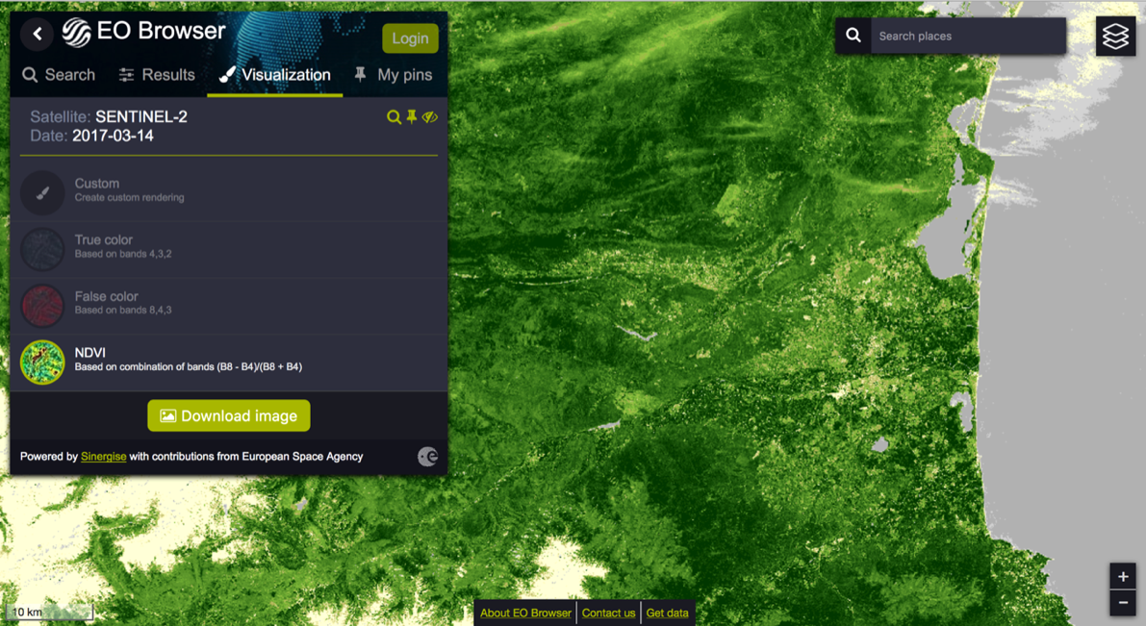
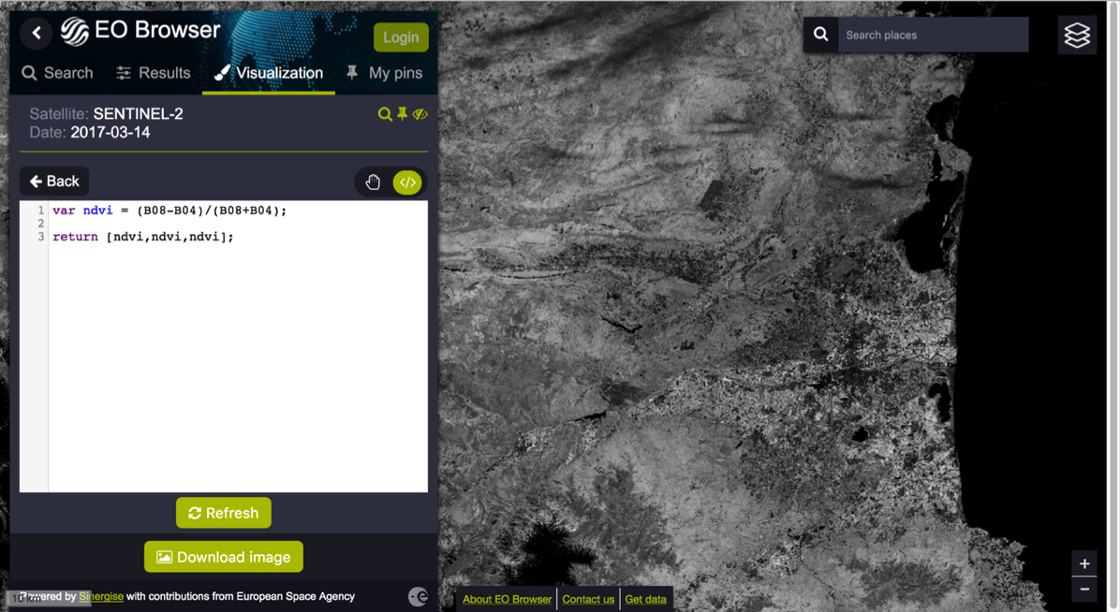
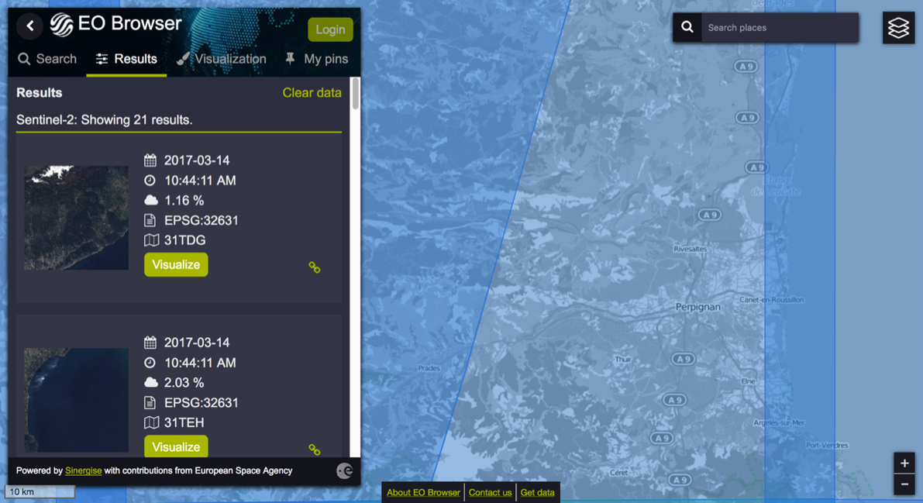
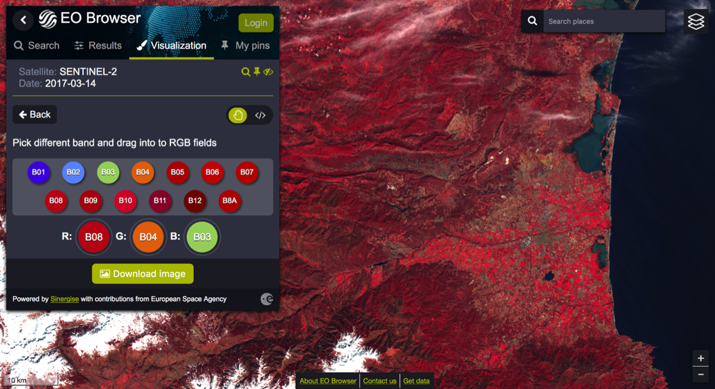
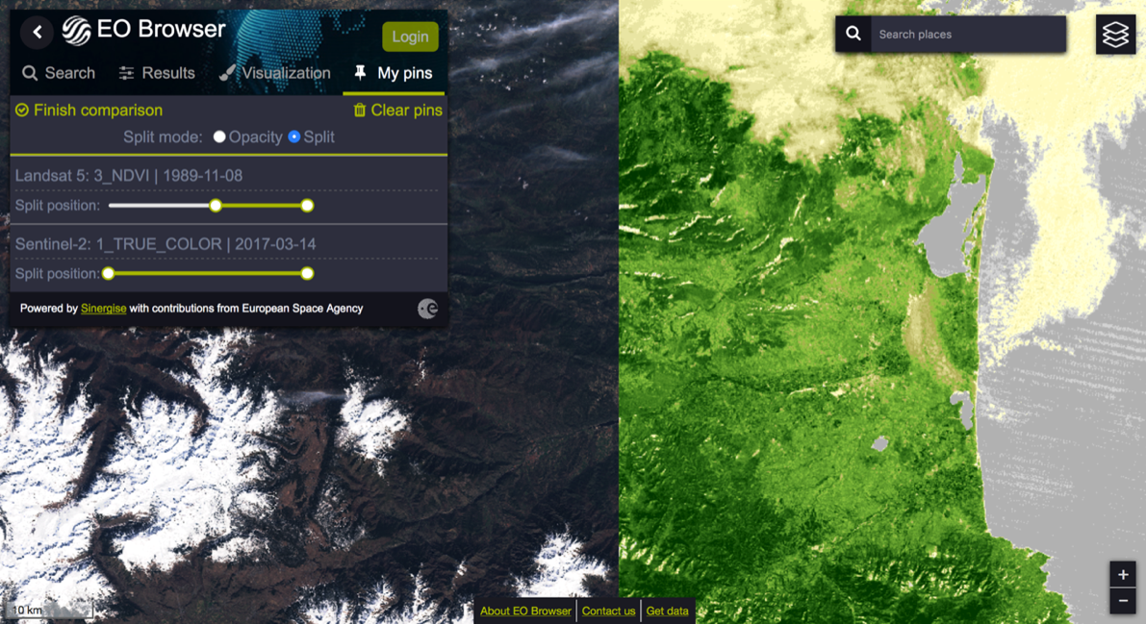
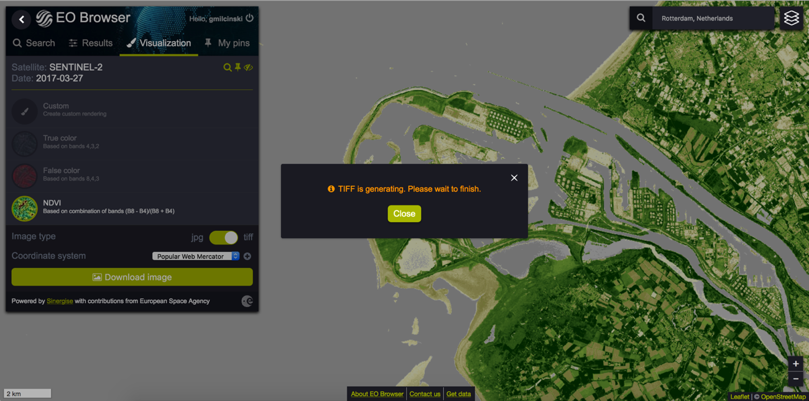
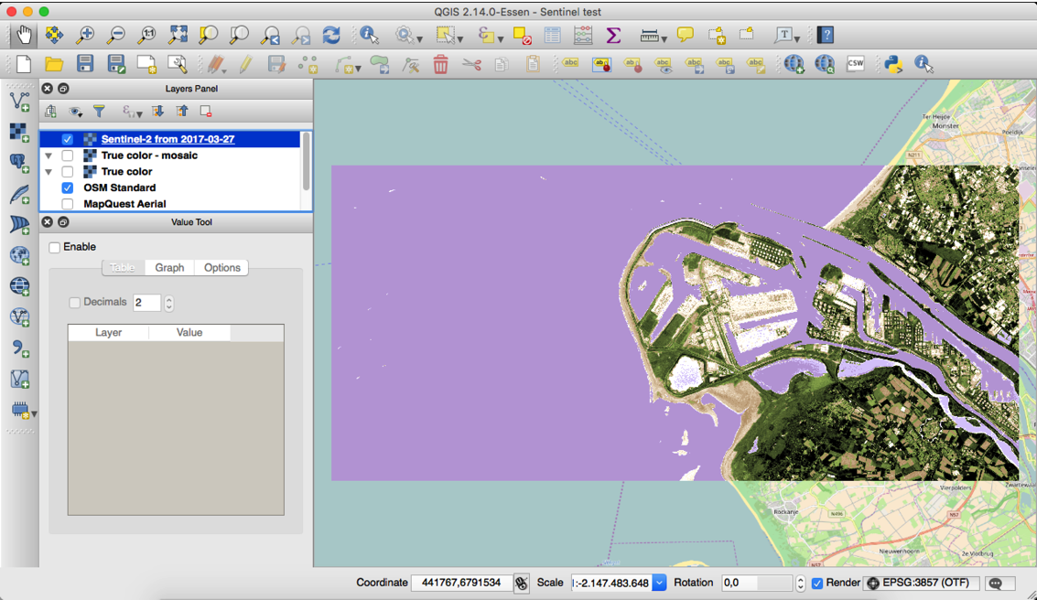
EO Browser
https://apps.sentinel-hub.com/eo-browser/

Slide 10
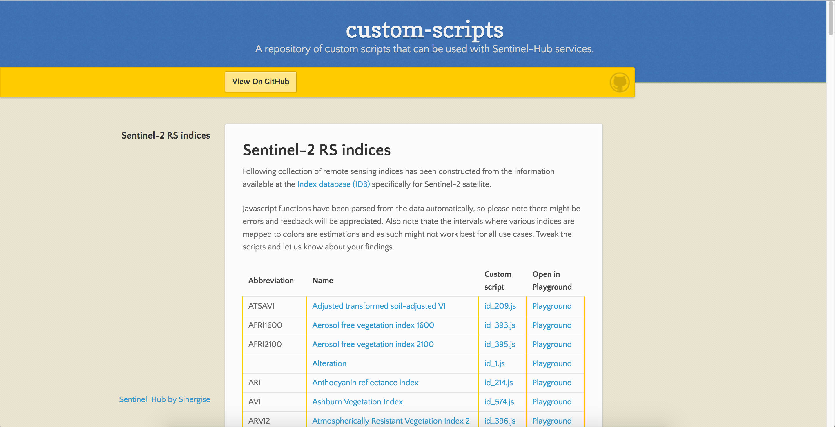
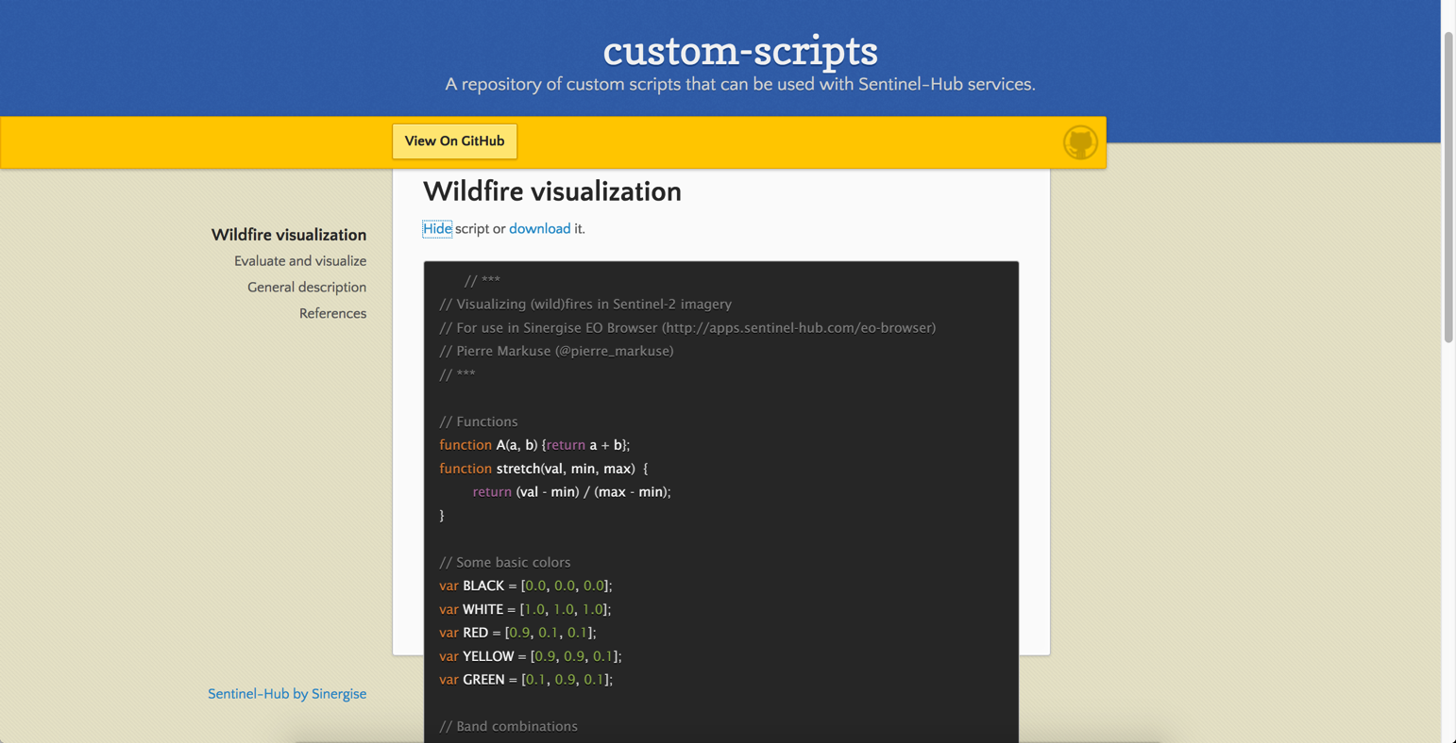
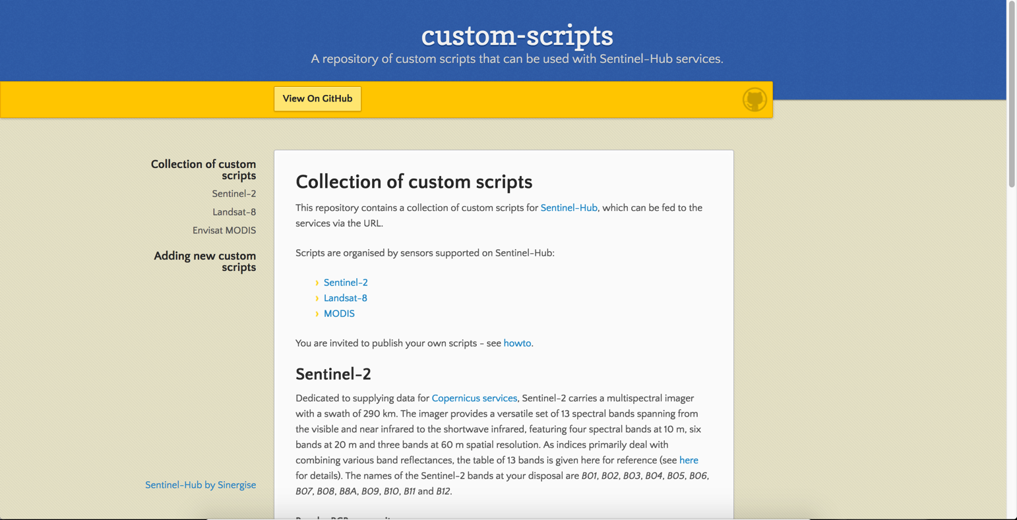
Custom Scripts
https://custom-scripts.sentinel-hub.com/

Slide 11
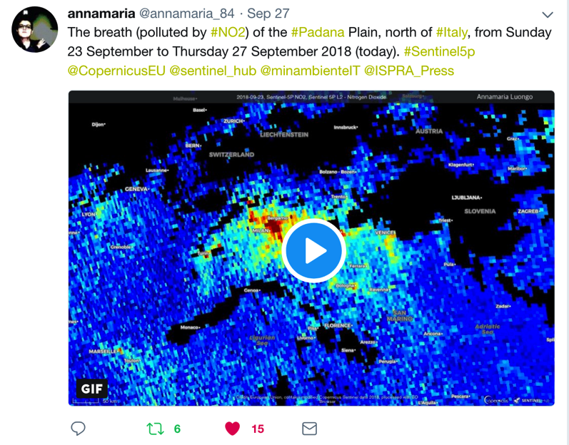
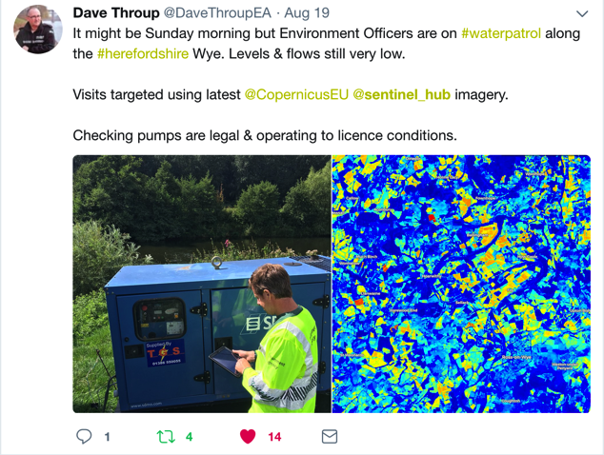
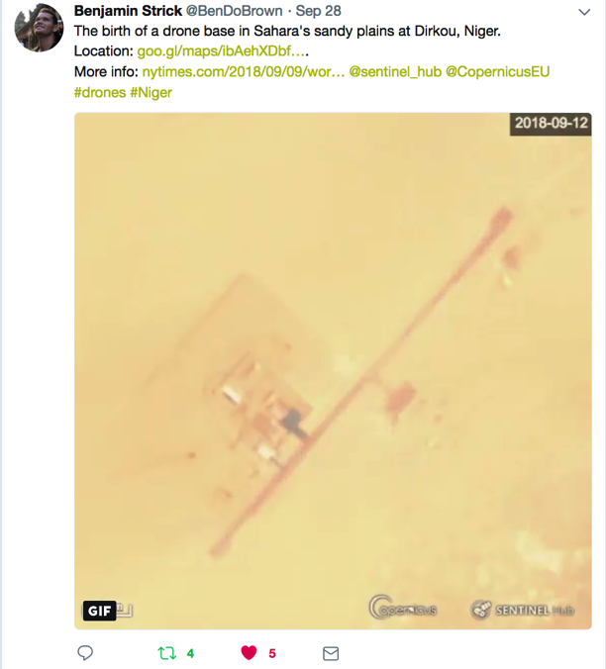
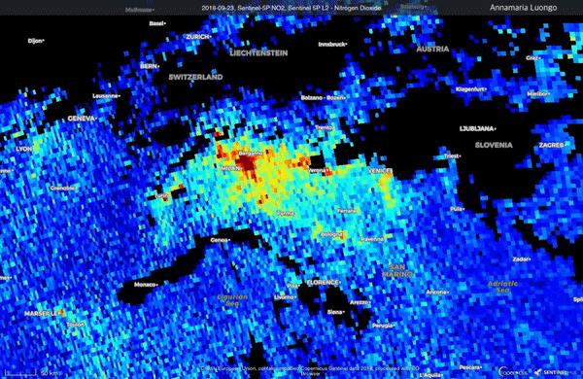
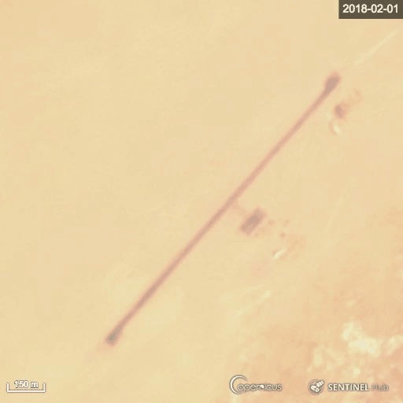
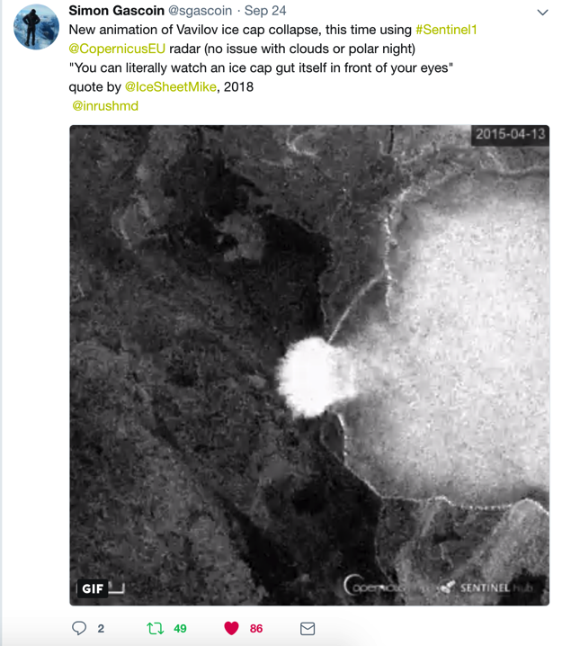
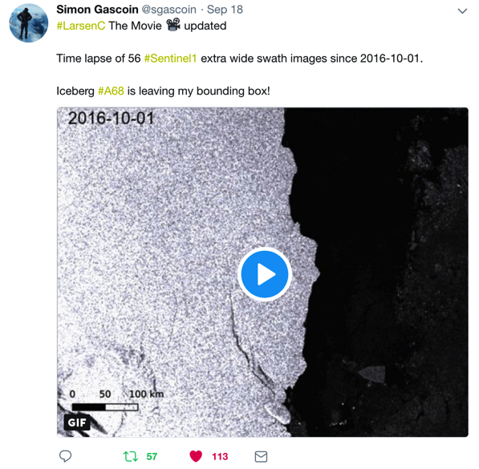
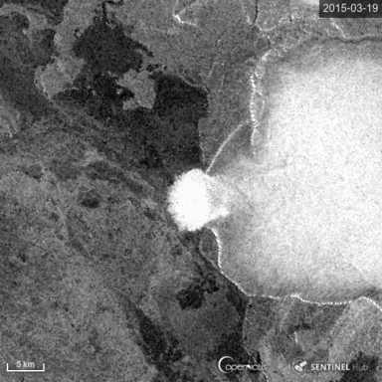
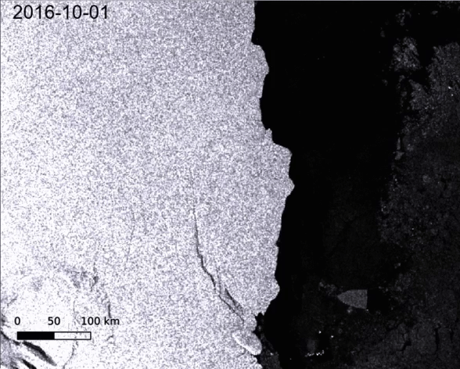
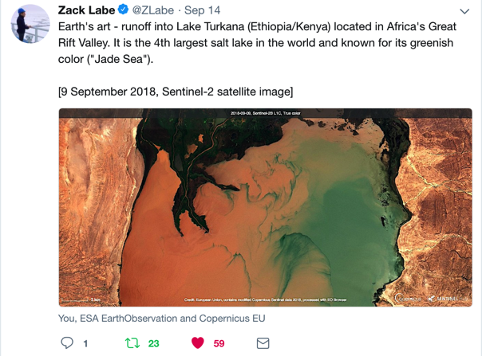

Slide 12
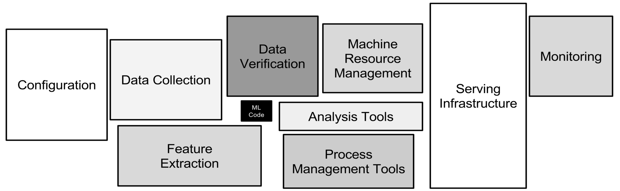
Challenges
label-maker
sentinelhub-py
classificationApp
geopedia
Docker
AWS SageMaker
AWS-lambdas
s2cloudless
eo-learn
ML/DL libraries
Sculley et al. Hidden Technical Debt in Machine Learning Systems, NIPS 2015

Slide 13
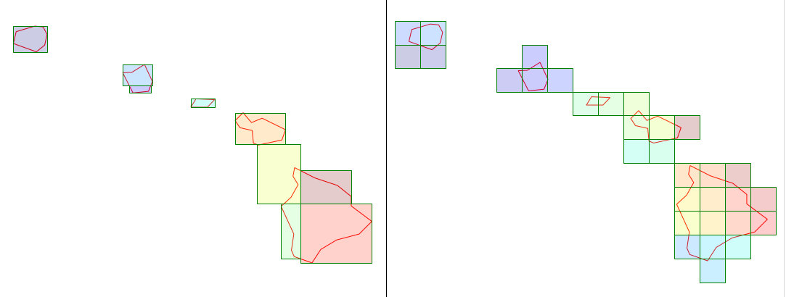
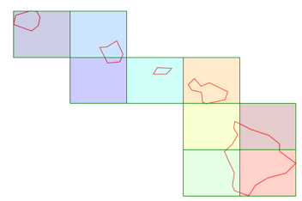
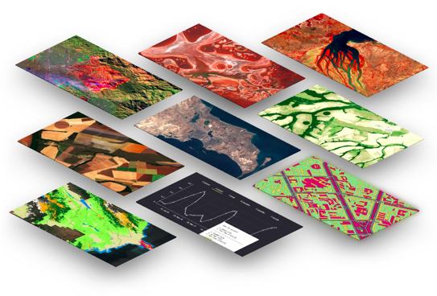
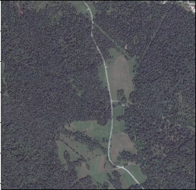
Data
https://services.sentinel-hub.com/ogc/wcs/<INSTANCE>
?SERVICE=WCS&REQUEST=GetCoverage
&COVERAGE=1_VV_ORTHORECTIFIED
&TIME=2018-07-17/2018-07-17
&BBOX=15.28815,107.07000,14.75496,106.09153
&RESX=20m&RESY=20m
&FORMAT=image/tiff
&SRS=EPSG:4326
DataSource.SENTINEL2_L1C
DataSource.SENTINEL2_L2A
DataSource.SENTINEL1_IW
DataSource.SENTINEL1_EW
DataSource.SENTINEL1_EW_SH
DataSource.DEM
DataSource.MODIS
DataSource.LANDSAT8
eo-learn modules to read MapBox high-resolution imagery
eo-learn modules to read (COG)-Tiff
task = MapboxXYZInput('mapbox.satellite', 'MAPBOX', ACCESS_TOKEN)

Slide 14
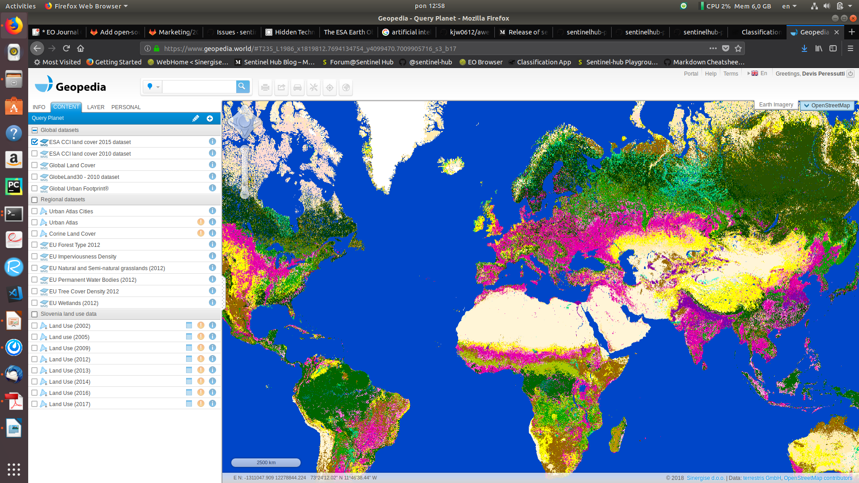
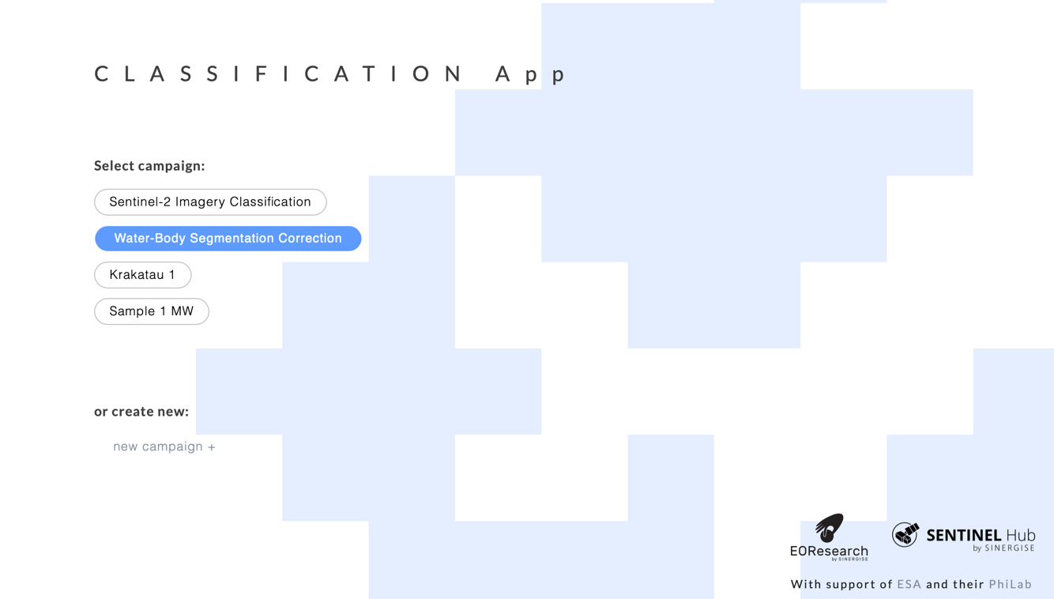
Labels
Collection of open-source label datasets on www.geopedia.world
open-source label collection tool apps.sentine-hub.com/classificationApp

Slide 15
Building blocks put together
BlueDot Water observatory
world-scale systems on a shoestring budget
LandUse/LandCover management system(s)
demo for Slovenia (see series of blog posts)

Slide 16
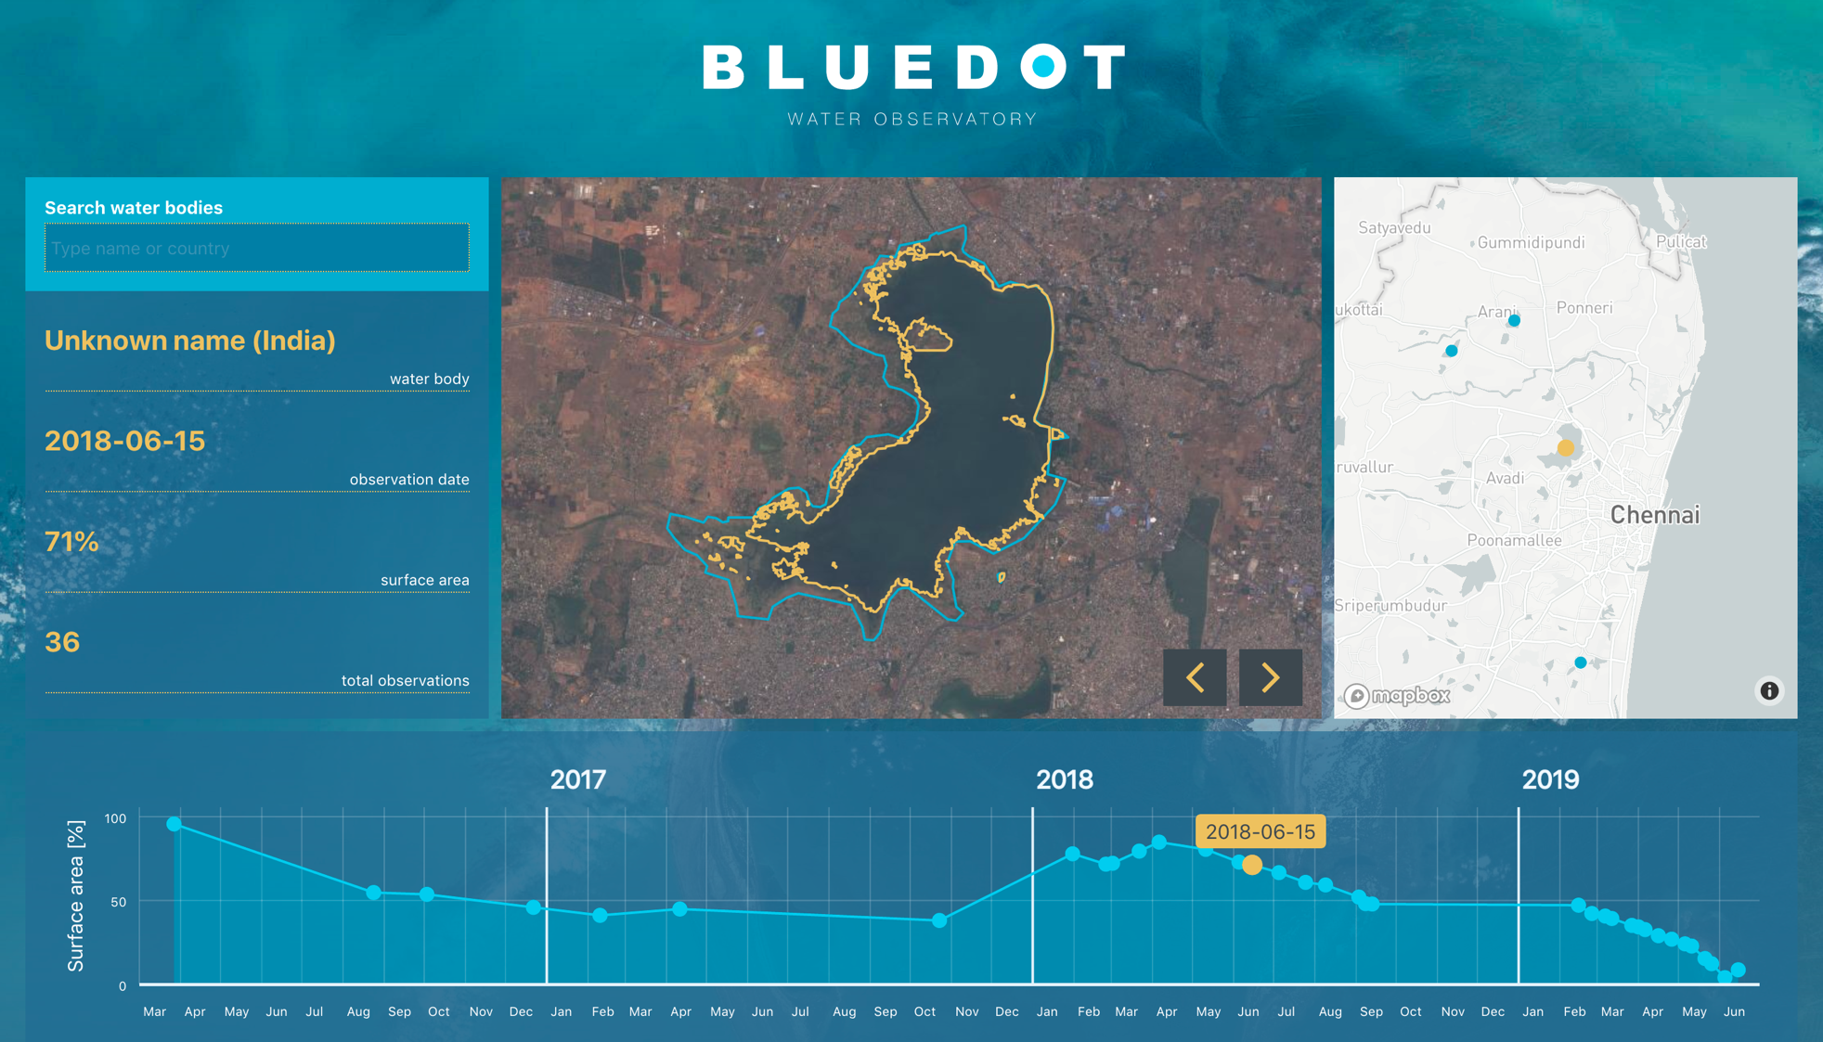
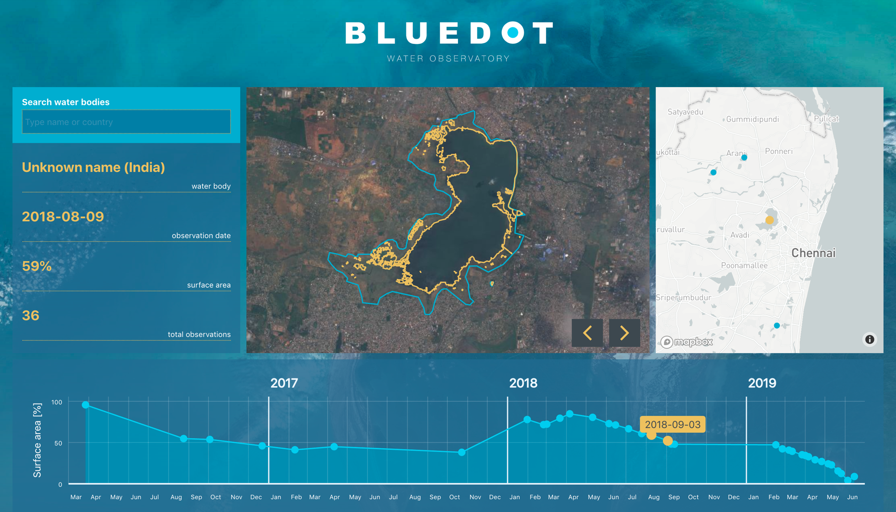
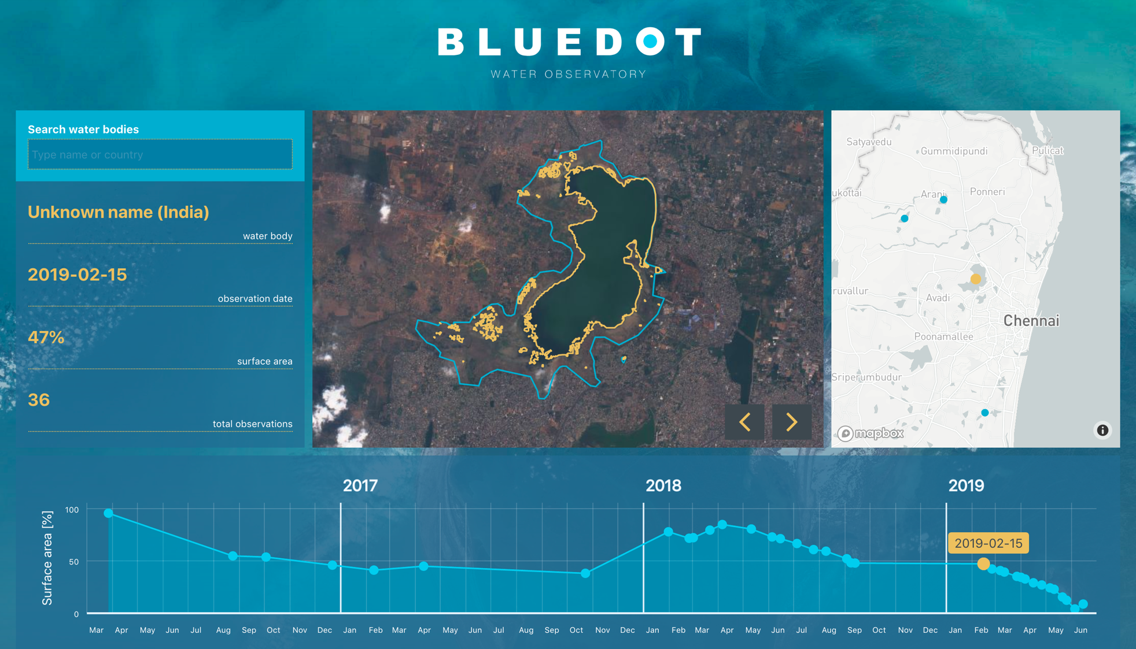
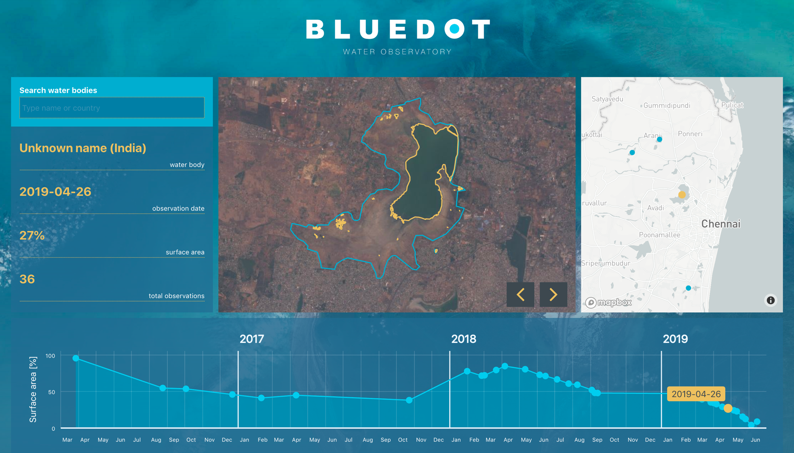
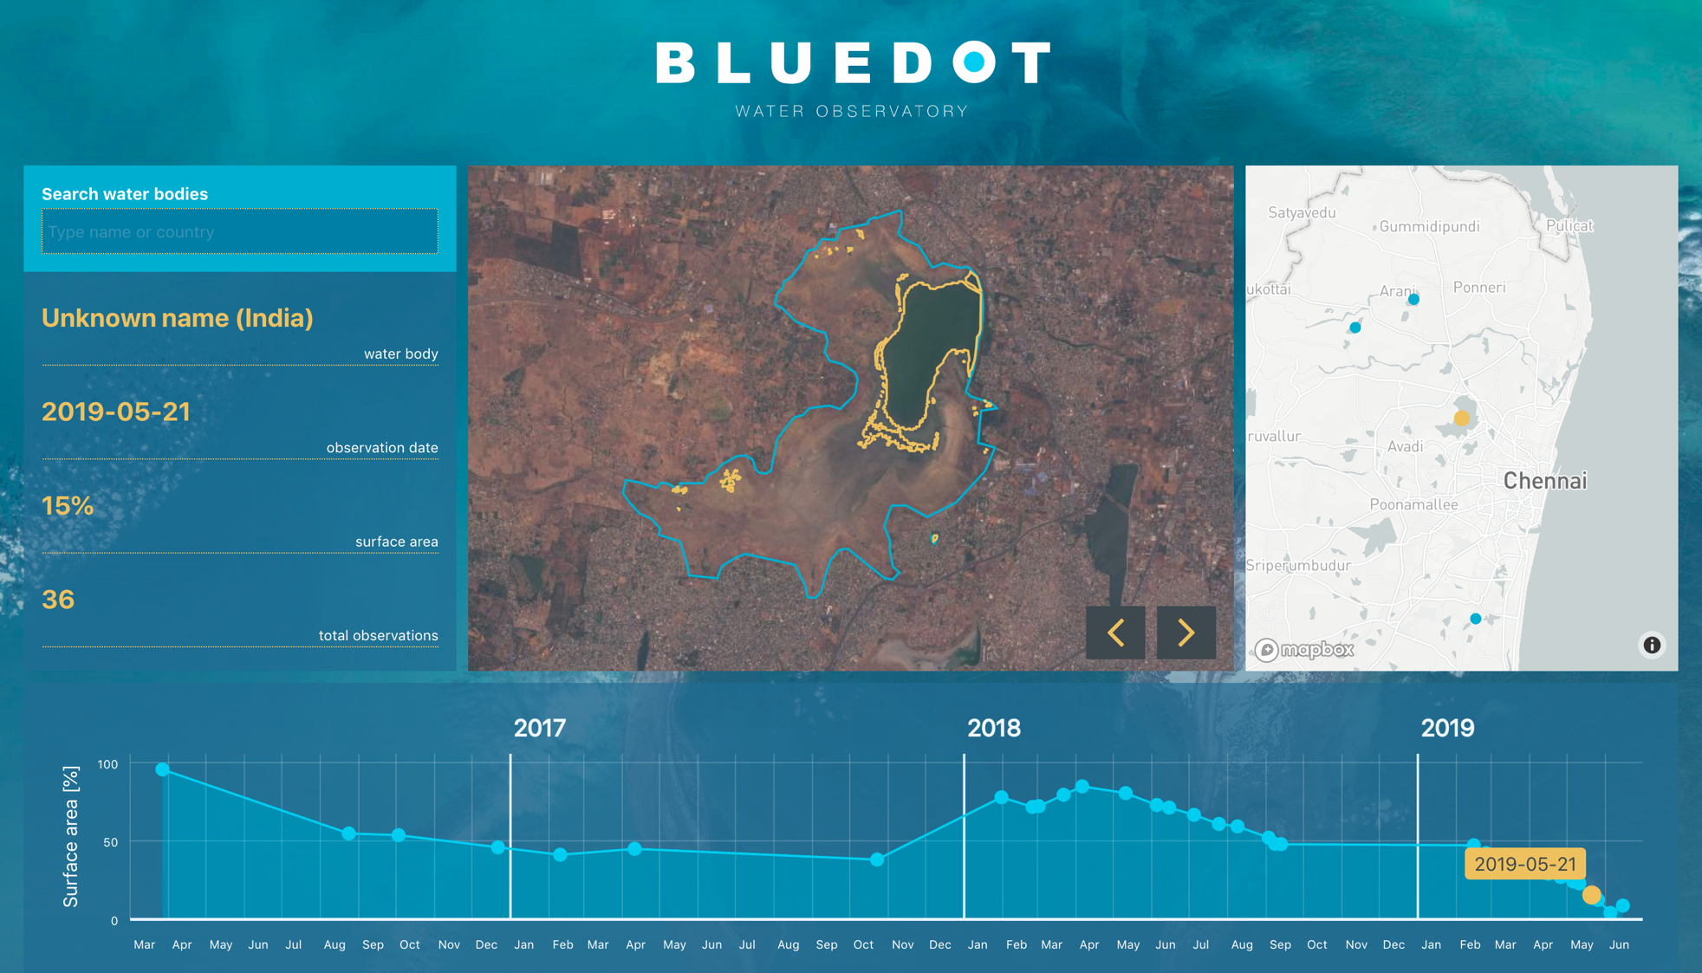

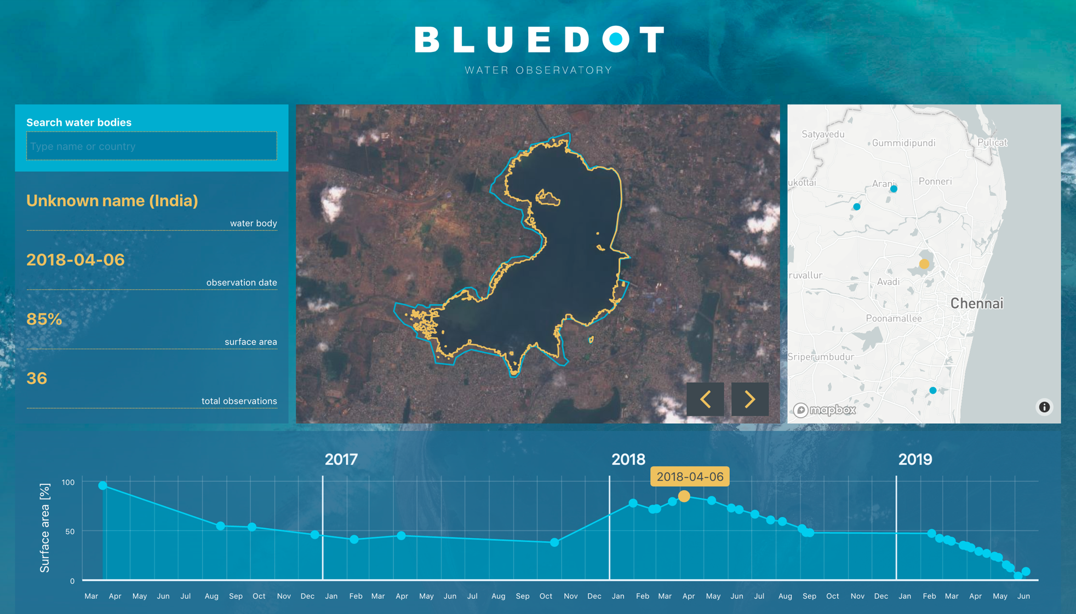

Slide 17
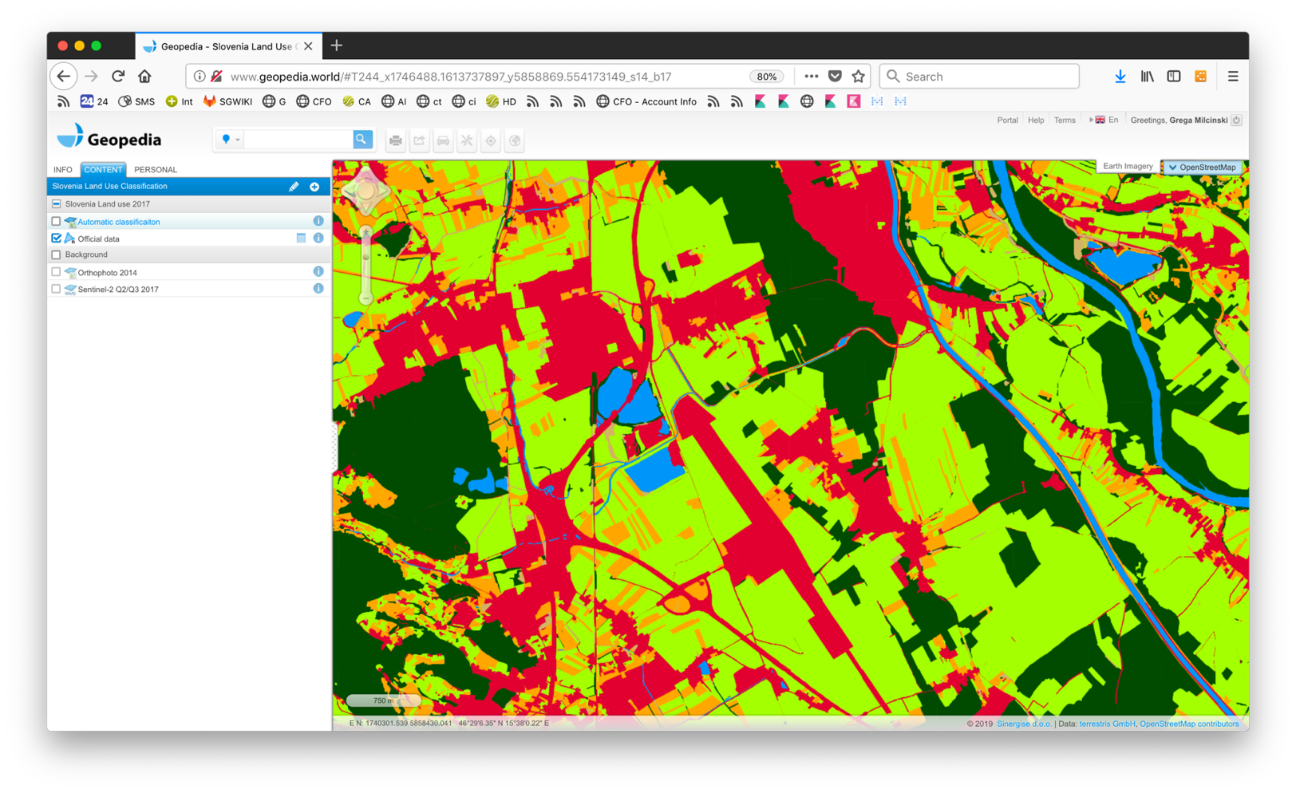
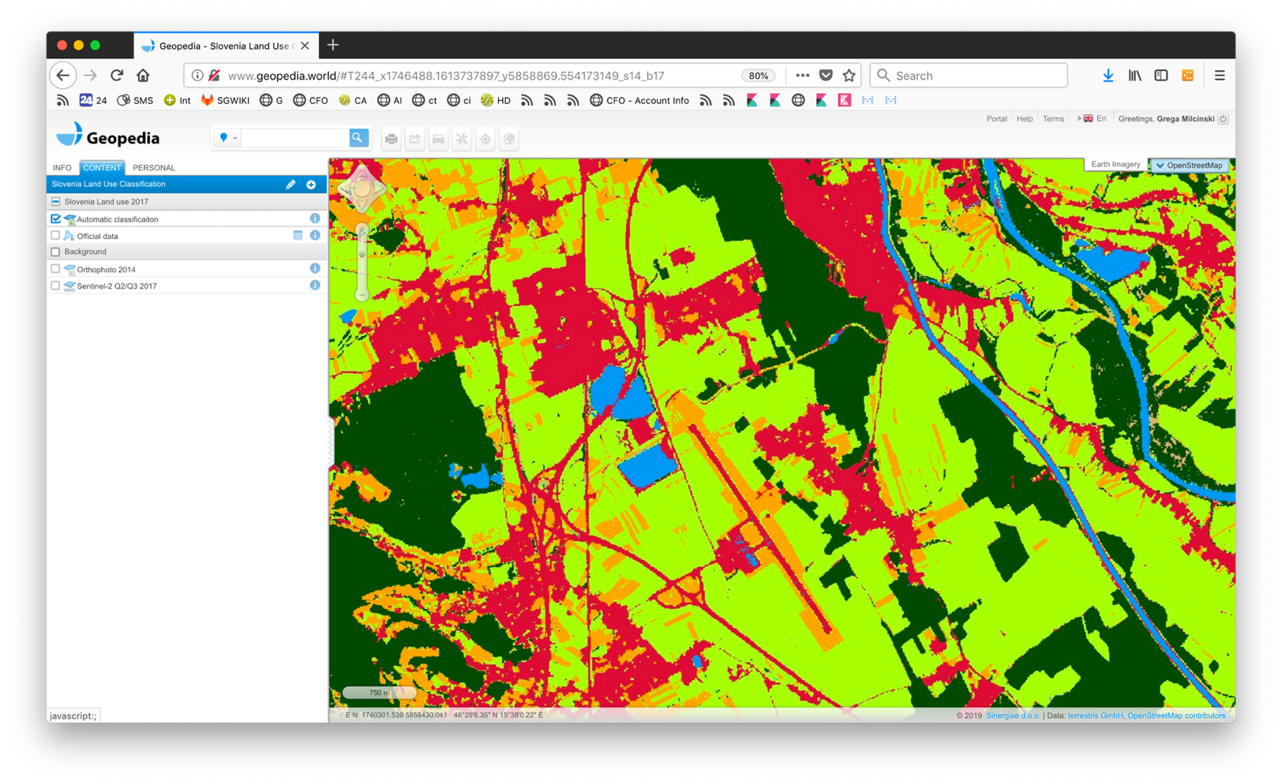
Land Classification (Slovenia)

Slide 18

How can one start the exploration?
https://github.com/sentinel-hub/norsc19-eo-learn-workshop

